Slide 1
Processor Architecture III: PIPE: Pipelined Implementation Introduction to Computer Systems 11th Lecture, Oct 25, 2021
Instructors:
Class 1: Chen Xiangqun, Sun Guangyu, Liu Xianhua
Class 2: Guan Xuetao
Class 3: Lu Junlin

Slide 2
Overview
General Principles of Pipelining
Goal
Difficulties
Creating a Pipelined Y86-64 Processor
Rearranging SEQ
Inserting pipeline registers
Problems with data and control hazards

Slide 3


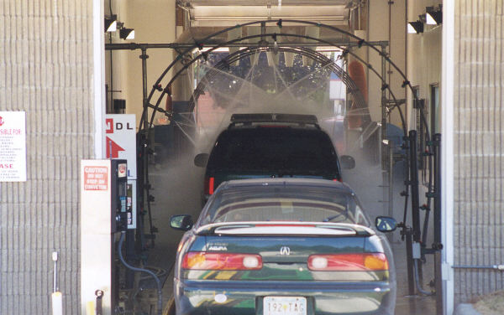
Real-World Pipelines: Car Washes
Sequential
Parallel
Pipelined
Idea
Divide process into independent stages
Move objects through stages in sequence
At any given times, multiple objects being processed

Slide 4
Computational Example
300 ps
20 ps
Combinational
logic
R
e
g
Delay = 320 ps
Throughput = 3.12 GIPS
Clock
System
Computation requires total of 300 picoseconds
Additional 20 picoseconds to save result in register
Must have clock cycle of at least 320 ps

Slide 5
3-Way Pipelined Version
100 ps
20 ps
100 ps
20 ps
100 ps
20 ps
Comb.
logic
A
R
e
g
Comb.
logic
B
R
e
g
Comb.
logic
C
R
e
g
Delay = 360 ps
Throughput = 8.33 GIPS
Clock
System
Divide combinational logic into 3 blocks of 100 ps each
Can begin new operation as soon as previous one passes through stage A.
Begin new operation every 120 ps
Overall latency increases
360 ps from start to finish

Slide 6
Pipeline Diagrams
Unpipelined
Cannot start new operation until previous one completes
3-Way Pipelined
Up to 3 operations in process simultaneously
OP1
OP2
OP3
Time
OP1
A
B
C
OP2
A
B
C
OP3
A
B
C
Time

Slide 7
Operating a Pipeline
239
241
300
359
Clock
OP1
A
B
C
OP2
A
B
C
OP3
A
B
C
0
120
240
360
480
640
Time
100 ps
20 ps
100 ps
20 ps
100 ps
20 ps
100 ps
100 ps
100 ps
20 ps
20 ps
20 ps
100 ps
100 ps
100 ps
20 ps
20 ps
20 ps
100 ps
100 ps
100 ps
20 ps
20 ps
20 ps
Comb.
logic
A
R
e
g
Comb.
logic
B
R
e
g
Comb.
logic
C
Comb.
logic
A
R
e
g
Comb.
logic
B
R
e
g
Comb.
logic
C
R
e
g
Comb.
logic
A
Comb.
logic
A
R
e
g
R
e
g
Comb.
logic
B
Comb.
logic
B
R
e
g
R
e
g
Comb.
logic
C
Comb.
logic
C
R
e
g
R
e
g
R
e
g
Clock
Clock
Clock
Clock

Slide 8
Limitations: Nonuniform Delays
50 ps
20 ps
150 ps
20 ps
100 ps
20 ps
Comb.
logic
A
R
e
g
Comb.
logic
B
R
e
g
Comb.
logic
C
R
e
g
Delay = 510 ps
Throughput = 5.88 GIPS
Clock
OP1
A
B
C
OP2
A
B
C
OP3
A
B
C
Time
Throughput limited by slowest stage
Other stages sit idle for much of the time
Challenging to partition system into balanced stages

Slide 9
Limitations: Register Overhead
50 ps
20 ps
50 ps
20 ps
50 ps
20 ps
50 ps
20 ps
50 ps
20 ps
50 ps
20 ps
Comb.
logic
R
e
g
Comb.
logic
R
e
g
Comb.
logic
R
e
g
Comb.
logic
R
e
g
Comb.
logic
R
e
g
Comb.
logic
R
e
g
Clock
Delay = 420 ps, Throughput = 14.29 GIPS
As try to deepen pipeline, overhead of loading registers becomes more significant
Percentage of clock cycle spent loading register:
1-stage pipeline: 6.25%
3-stage pipeline: 16.67%
6-stage pipeline: 28.57%
High speeds of modern processor designs obtained through very deep pipelining

Slide 10
Data Dependencies
Combinational
logic
R
e
g
Clock
OP1
OP2
OP3
Time
System
Each operation depends on result from preceding one

Slide 11
Data Hazards
Comb.
logic
A
R
e
g
Comb.
logic
B
R
e
g
Comb.
logic
C
R
e
g
Clock
OP1
A
B
C
OP2
A
B
C
OP3
A
B
C
OP4
A
B
C
Time
Result does not feed back around in time for next operation
Pipelining has changed behavior of system

Slide 12
Data Dependencies in Processors
1 irmovq $50, %rax
2 addq %rax , %rbx
3 mrmovq 100( %rbx ), %rdx
Result from one instruction used as operand for another
Read-after-write (RAW) dependency
Very common in actual programs
Must make sure our pipeline handles these properly
Get correct results
Minimize performance impact

Slide 13
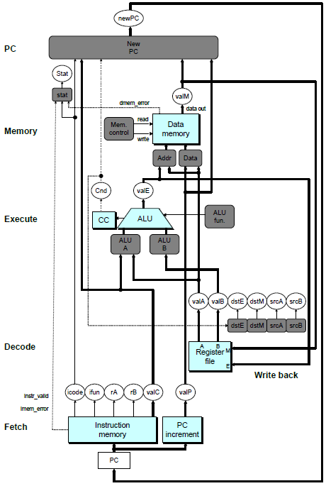
SEQ Hardware
Stages occur in sequence
One operation in process at a time

Slide 14
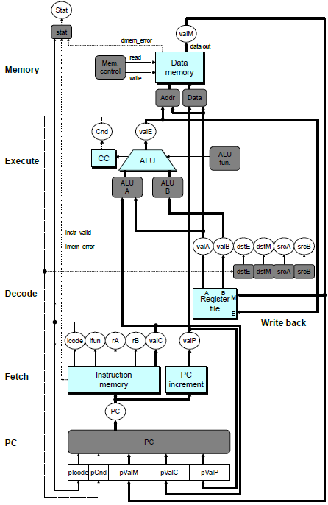
SEQ+ Hardware
Still sequential implementation
Reorder PC stage to put at beginning
PC Stage
Task is to select PC for current instruction
Based on results computed by previous instruction
Processor State
PC is no longer stored in register
But, can determine PC based on other stored information

Slide 15
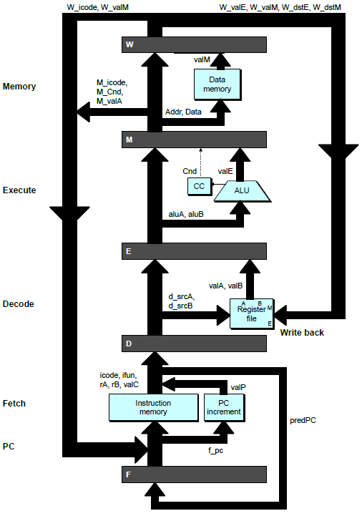
Adding Pipeline Registers
PC
newPC
valE
,
valM
Write back
valM
Data
Memory
Data
memory
memory
Addr
, Data
valE
CC
CC
ALU
Execute
Cnd
ALU
aluA
,
aluB
valA
,
valB
Decode
srcA
,
srcB
A
A
B
dstA
,
dstB
B
M
Register
M
Register
Register
Register
file
file
file
file
E
E
icode
,
ifun
valP
rA
,
rB
valC
Instruction
PC
Instruction
PC
Fetch
memory
increment
memory
increment
PC

Slide 16
Pipeline Stages
Fetch
Select current PC
Read instruction
Compute incremented PC
Decode
Read program registers
Execute
Operate ALU
Memory
Read or write data memory
Write Back
Update register file

Slide 17
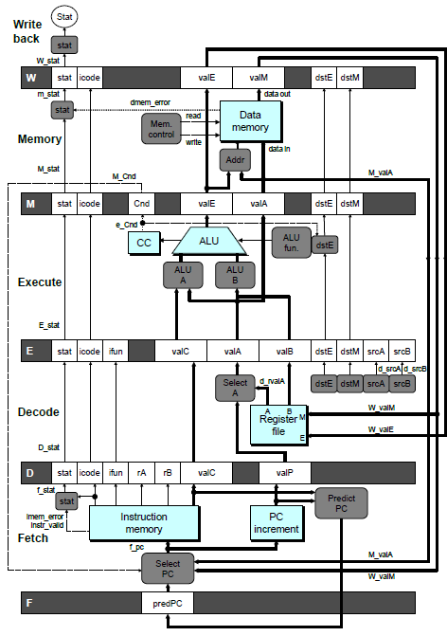
PIPE- Hardware
Pipeline registers hold intermediate values from instruction execution
Forward (Upward) Paths
Values passed from one stage to next
Cannot jump past stages
e.g., valC passes through decode

Slide 18
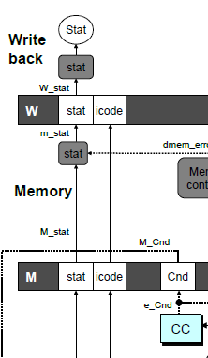
Signal Naming Conventions
S_Field
Value of Field held in stage S pipeline register
s_Field
Value of Field computed in stage S

Slide 19
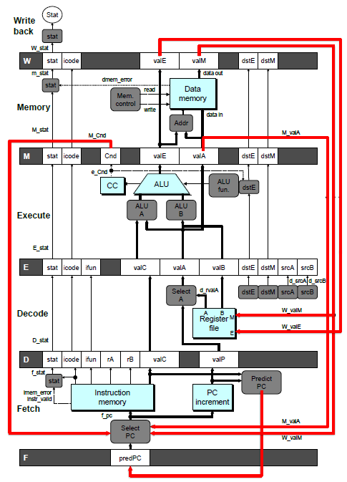
Feedback Paths
Predicted PC
Guess value of next PC
Branch information
Jump taken/not-taken
Fall-through or target address
Return point
Read from memory
Register updates
To register file write ports

Slide 20
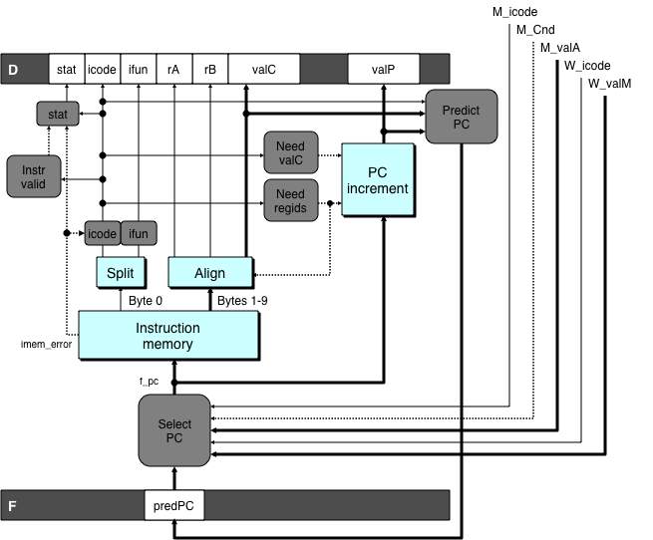
Predicting the PC
Start fetch of new instruction after current one has completed fetch stage
Not enough time to reliably determine next instruction
Guess which instruction will follow
Recover if prediction was incorrect

Slide 21
Our Prediction Strategy
Instructions that Don’t Transfer Control
Predict next PC to be valP
Always reliable
Call and Unconditional Jumps
Predict next PC to be valC (destination)
Always reliable
Conditional Jumps
Predict next PC to be valC (destination)
Only correct if branch is taken
Typically right 60% of time
Return Instruction
Don’t try to predict

Slide 22
Recovering from PC Misprediction
Mispredicted Jump
Will see branch condition flag once instruction reaches memory stage
Can get fall-through PC from valA (value M_valA)
Return Instruction
Will get return PC when ret reaches write-back stage (W_valM)

Slide 23
Pipeline Demonstration
1
2
3
4
5
6
7
8
9
irmovq $1,%rax #I1
F
D
E
M
W
irmovq $2,%rcx #I2
F
D
E
M
W
irmovq $3,%rdx #I3
F
D
E
M
W
irmovq $4,%rbx #I4
F
D
E
M
W
halt #I5
F
D
E
M
W
Cycle 5
File: demo-basic.ys
W
I1
M
I2
E
I3
D
I4
F
I5

Slide 24
Data Dependencies: No Nop
# demo-h0.ys
1
2
3
4
5
6
7
8
0x000:
irmovq
$10,%
rdx
F
D
E
M
W
0x00a:
irmovq
$3,%
rax
F
D
E
M
W
0x014:
addq
%
rdx
,%
rax
F
D
E
M
W
0x016: halt
F
D
E
M
W
Cycle 4
M
M_
valE
= 10
M_
dstE
=
%
rdx
E
e_
valE
f
0 + 3 = 3
E_
dstE
=
%
rax
D
D
Error
f
valA
f
valA
R[
R[
]
]
=
=
0
%
0
%
rdx
rdx
f
valB
f
valB
R[
R[
]
]
=
=
0
%
0
%
rax
rax

Slide 25
Data Dependencies: 1 Nop
# demo-h1.ys
1
2
3
4
5
6
7
8
9
0x000:
irmovq
$10,%
rdx
F
D
E
M
W
0x00a:
irmovq
$3,%
rax
F
D
E
M
W
F
F
D
D
E
E
M
M
W
0x014:
nop
W
F
F
D
D
E
E
M
M
W
0x015:
addq
%
rdx
,%
rax
W
F
F
D
D
E
E
M
M
W
0x017: halt
W
Cycle 5
W
W
f
R[
f
R[
]
]
10
%
10
%
rdx
rdx
M
M_
valE
= 3
M_
dstE
=
%
rax
•
•
•
D
D
Error
f
valA
f
valA
R[
R[
]
]
=
=
0
%
0
%
rdx
rdx
f
valB
f
valB
R[
R[
]
]
=
=
0
%
0
%
rax
rax

Slide 26
Data Dependencies: 2 Nop’s
# demo-h2.ys
1
2
3
4
5
6
7
8
9
10
F
F
D
D
E
E
M
M
W
0x000:
irmovq
$10,%
rdx
W
F
F
D
D
E
E
M
M
W
0x00a:
irmovq
$3,%
rax
W
F
F
D
D
E
E
M
M
W
0x014:
nop
W
F
F
D
D
E
E
M
M
W
0x015:
nop
W
F
F
D
D
E
E
M
M
W
0x016:
addq
%
rdx
,%
rax
W
F
F
D
D
E
E
M
M
W
0x018: halt
W
Cycle 6
W
W
W
f
f
R[
f
R[
R[
]
]
]
3
3
%
3
%
%
rax
rax
rax
•
•
•
•
•
•
D
D
D
f
f
valA
f
valA
valA
R[
R[
R[
]
]
]
=
=
=
10
10
%
10
Error
%
%
rdx
rdx
rdx
f
f
valB
f
valB
valB
R[
R[
R[
]
]
]
=
=
=
0
0
%
0
%
%
rax
rax
rax

Slide 27
Data Dependencies: 3 Nop’s
# demo-h3.ys
1
2
3
4
5
6
7
8
9
10
11
F
F
D
D
E
E
M
M
W
0x000:
irmovq
$10,%
rdx
W
F
F
D
D
E
E
M
M
W
0x00a:
irmovq
$3,%
rax
W
F
F
D
D
E
E
M
M
W
0x014:
nop
W
F
F
D
D
E
E
M
M
W
0x015:
nop
W
F
F
D
D
E
E
M
M
W
0x016:
nop
W
F
F
D
D
E
E
M
M
W
0x017:
addq
%
rdx
,%
rax
W
F
F
D
D
E
E
M
M
W
0x019: halt
W
Cycle 6
W
W
f
R[
f
R[
]
]
3
%
3
%
rax
rax
Cycle 7
D
D
f
valA
f
valA
R[
R[
]
]
=
=
10
%
10
%
rdx
rdx
f
valB
f
valB
R[
R[
]
]
=
=
3
%
3
%
rax
rax

Slide 28
Stalling for Data Dependencies
# demo-h2.ys
1
2
3
4
5
6
7
8
9
10
11
0x000: irmovq $10,%rdx
F
D
E
M
W
0x00a: irmovq $3,%rax
F
D
E
M
W
0x014: nop
F
D
E
M
W
0x015: nop
F
D
E
M
W
bubble
E
M
W
0x016: addq %rdx,%rax
F
D
D
E
M
W
0x018: halt
F
F
D
E
M
W
If instruction follows too closely after one that writes register, slow it down
Hold instruction in decode
Dynamically inject nop into execute stage

Slide 29
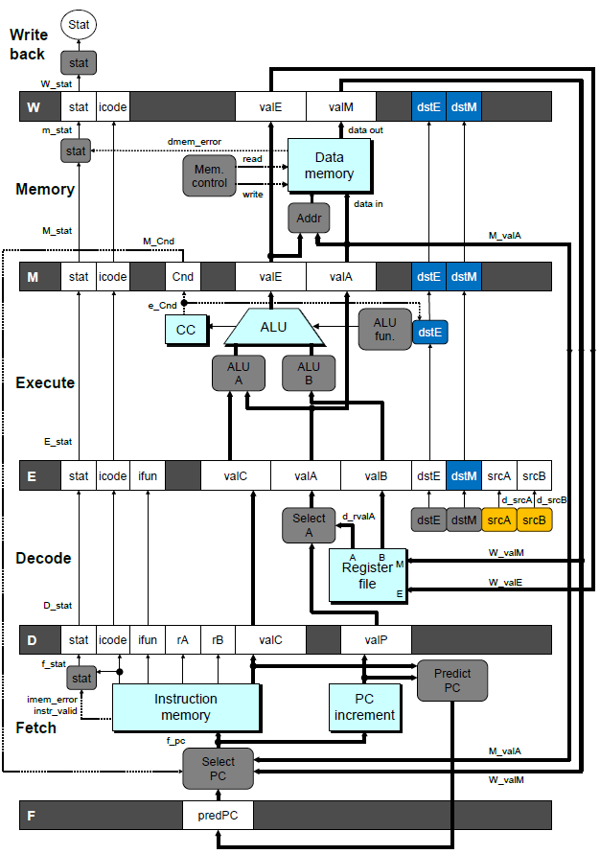
Stall Condition
Source Registers
srcA and srcB of current instruction in decode stage
Destination Registers
dstE and dstM fields
Instructions in execute, memory, and write-back stages
Special Case
Don’t stall for register ID 15 (0xF)
Indicates absence of register operand
Or failed cond. move

Slide 30
Detecting Stall Condition
# demo-h2.ys
1
2
3
4
5
6
7
8
9
10
11
0x000: irmovq $10,%rdx
F
D
E
M
W
0x00a: irmovq $3,%rax
F
D
E
M
W
0x014: nop
F
D
E
M
W
0x015: nop
F
D
E
M
W
bubble
E
M
W
0x016: addq %rdx,%rax
F
D
D
E
M
W
0x018: halt
F
F
D
E
M
W
Cycle 6
W
W_dstE = %rax
W_valE = 3
•
•
•
D
srcA = %rdx
srcB = %rax

Slide 31
Stalling X3
# demo-h0.ys
1
2
3
4
5
6
7
8
9
10
11
0x000: irmovq $10,%rdx
F
D
E
M
W
0x00a: irmovq $3,%rax
F
D
E
M
W
bubble
E
M
W
bubble
E
M
W
bubble
E
M
W
0x014: addq %rdx,%rax
F
D
D
D
D
E
M
W
0x016: halt
F
F
F
F
D
E
M
W
Cycle 6
W
Cycle 5
W_dstE = %rax
M
Cycle 4
M_dstE = %rax
•
•
•
E
•
•
•
e_dstE = %rax
D
D
D
srcA = %rdx
srcB = %rax
srcA = %rdx
srcB = %rax
srcA = %rdx
srcB = %rax

Slide 32
What Happens When Stalling?
# demo-h0.ys
Cycle 4
Cycle 5
Cycle 6
Cycle 7
Cycle 8
0x000: irmovq $10,%rdx
0x000: irmovq $10,%rdx
0x00a: irmovq $3,%rax
bubble
Write Back
bubble
0x00a: irmovq $3,%rax
0x000: irmovq $10,%rdx
0x00a: irmovq $3,%rax
bubble
bubble
Memory
bubble
0x014: addq %rdx,%rax
0x00a: irmovq $3,%rax
bubble
bubble
bubble
Execute
0x014: addq %rdx,%rax
0x016: halt
0x014: addq %rdx,%rax
0x014: addq %rdx,%rax
0x014: addq %rdx,%rax
0x014: addq %rdx,%rax
Decode
0x016: halt
0x016: halt
0x016: halt
0x016: halt
Fetch
0x016: halt
Stalling instruction held back in decode stage
Following instruction stays in fetch stage
Bubbles injected into execute stage
Like dynamically generated nop’s
Move through later stages

Slide 33
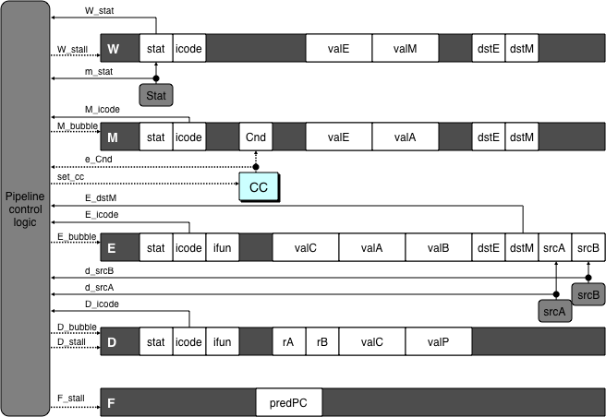
Implementing Stalling
Pipeline Control
Combinational logic detects stall condition
Sets mode signals for how pipeline registers should update

Slide 34
Pipeline Register Modes
Rising
Rising
Input = y
Output = x
_
clock
_
Output = y
clock
Normal
x
x
y
y
stall
bubble
= 0
= 0
Rising
Rising
Input = y
Output = x
_
clock
_
Output = x
clock
Stall
x
x
x
x
stall
bubble
= 1
= 0
Rising
Rising
Input = y
Output = x
_
clock
_
Output =
nop
clock
n
Bubble
x
x
o
p
stall
bubble
= 0
= 1

Slide 35
Data Forwarding
Naïve Pipeline
Register isn’t written until completion of write-back stage
Source operands read from register file in decode stage
Needs to be in register file at start of stage
Observation
Value generated in execute or memory stage
Trick
Pass value directly from generating instruction to decode stage
Needs to be available at end of decode stage

Slide 36
Data Forwarding Example
# demo-h2.ys
1
2
3
4
5
6
7
8
9
10
F
F
D
D
E
E
M
M
W
0x000:
irmovq
$10,%
rdx
W
F
F
D
D
E
E
M
M
W
0x00a:
irmovq
$3,%
rax
W
F
F
D
D
E
E
M
M
W
0x014:
nop
W
F
F
D
D
E
E
M
M
W
0x015:
nop
W
F
F
D
D
E
E
M
M
W
0x016:
addq
%
rdx
,%
rax
W
F
F
D
D
E
E
M
M
W
0x018: halt
W
irmovq in write-back stage
Destination value in W pipeline register
Forward as valB for decode stage
Cycle 6
W
W_
dstE
=
%
rax
R[
%
rax
]
f
3
W_
valE
= 3
•
•
•
D
srcA
=
%
rdx
valA
f
R[
%
rdx
]
=
10
srcB
=
%
rax
valB
f
W_
valE
=
3

Slide 37
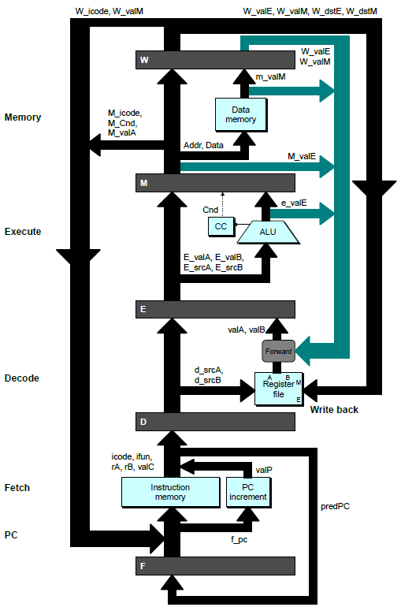
Bypass Paths
Decode Stage
Forwarding logic selects valA and valB
Normally from register file
Forwarding: get valA or valB from later pipeline stage
Forwarding Sources
Execute: valE
Memory: valE, valM
Write back: valE, valM

Slide 38
Data Forwarding Example #2
# demo-h0.ys
1
2
3
4
5
6
7
8
0x000: irmovq $10,%rdx
F
D
E
M
W
0x00a: irmovq $3,%rax
F
D
E
M
W
0x014: addq %rdx,%rax
F
D
E
M
W
0x016: halt
F
D
E
M
W
Register %rdx
Generated by ALU during previous cycle
Forward from memory as valA
Register %rax
Value just generated by ALU
Forward from execute as valB
Cycle 4
M
M_dstE = %rdx
M_valE = 10
E
E_dstE = %rax
e_valE f 0 + 3 = 3
D
srcA = %rdx
srcB = %rax
valA f M_valE = 10
valB f e_valE = 3

Slide 39
Forwarding Priority
# demo-priority.ys
1
2
3
4
5
6
7
8
9
10
F
F
D
D
E
E
M
M
W
0x000: irmovq $1, %rax
W
F
F
D
D
E
E
M
M
W
0x00a: irmovq $2, %rax
W
F
F
D
D
E
E
M
M
W
0x014: irmovq $3, %rax
W
F
F
D
D
E
E
M
M
W
0x01e: rrmovq %rax, %rdx
W
F
F
D
D
E
E
M
M
W
0x020: halt
W
Multiple Forwarding Choices
Which one should have priority
Match serial semantics
Use matching value from earliest pipeline stage
Cycle 5
W
W
f
R[
f
R[
]
]
3
%
1
%
rax
rax
W
M
f
R[
f
R[
]
]
3
%
2
%
rax
rax
W
E
f
R[
f
R[
]
]
3
%
3
%
rax
rax
D
D
D
f
f
valA
f
valA
valA
R[
R[
R[
]
]
]
=
=
=
10
10
%
?
%
%
rax
rdx
rdx
f
f
valB
f
valB
valB
R[
R[
0
%
rax
]
=
0

Slide 40
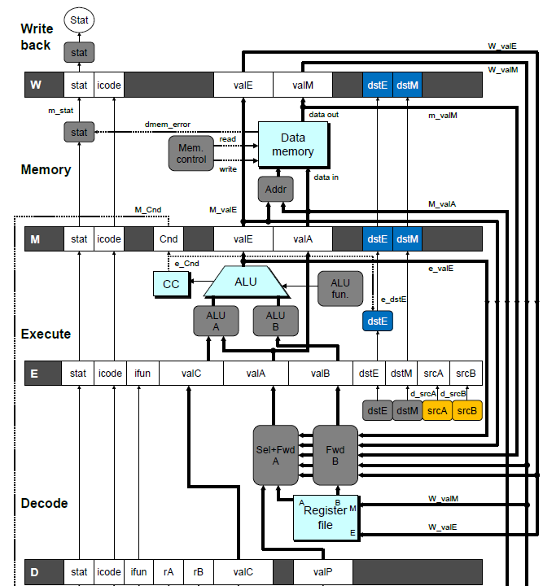
Implementing Forwarding
Add additional feedback paths from E, M, and W pipeline registers into decode stage
Create logic blocks to select from multiple sources for valA and valB in decode stage

Slide 41
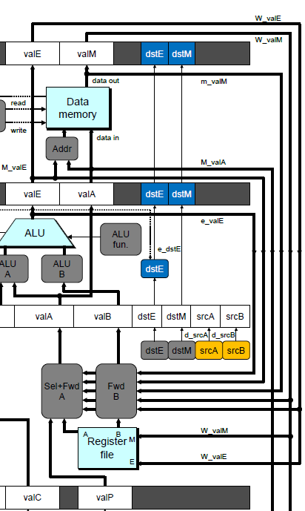
Implementing Forwarding
## What should be the A value?
int d_valA = [
# Use incremented PC
D_icode in { ICALL, IJXX } : D_valP;
# Forward valE from execute
d_srcA == e_dstE : e_valE;
# Forward valM from memory
d_srcA == M_dstM : m_valM;
# Forward valE from memory
d_srcA == M_dstE : M_valE;
# Forward valM from write back d_srcA == W_dstM : W_valM;
# Forward valE from write back
d_srcA == W_dstE : W_valE;
# Use value read from register file
1 : d_rvalA;
];

Slide 42
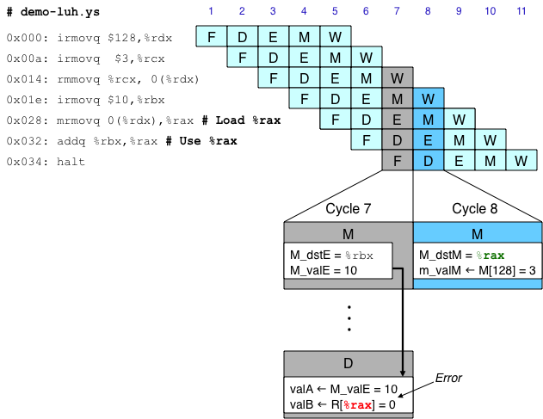
Limitation of Forwarding
Load-use dependency
Value needed by end of decode stage in cycle 7
Value read from memory in memory stage of cycle 8

Slide 43
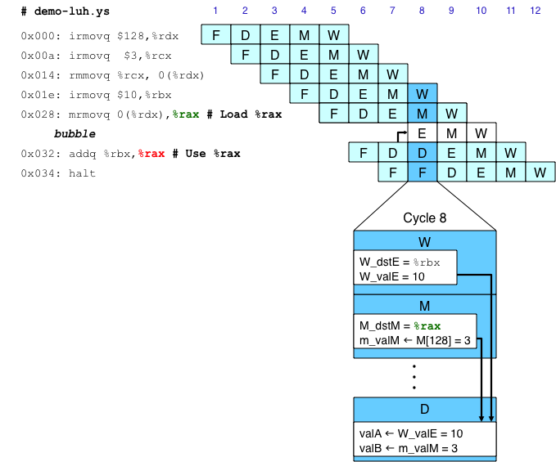
Avoiding Load/Use Hazard
Stall using instruction for one cycle
Can then pick up loaded value by forwarding from memory stage

Slide 44
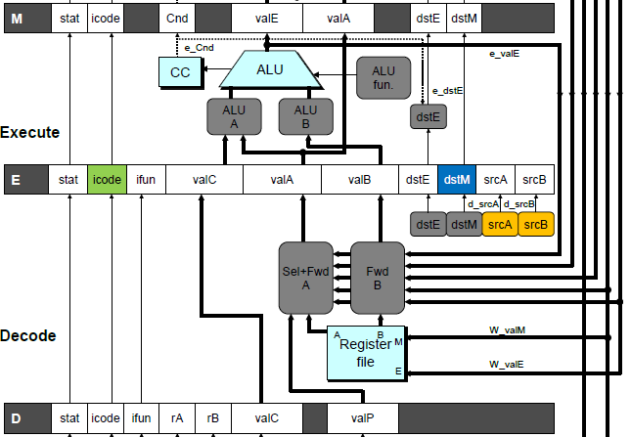
Detecting Load/Use Hazard
Condition | Trigger
Load/Use Hazard | E_icode in { IMRMOVQ, IPOPQ } && E_dstM in { d_srcA, d_srcB }

Slide 45
Control for Load/Use Hazard
# demo
-
luh
.
ys
1
2
3
4
5
6
7
8
9
10
11
12
F
F
D
D
E
E
M
M
W
0x000:
irmovq
$128,%
rdx
W
F
F
D
D
E
E
M
M
W
0x00a:
irmovq
$3,%
rcx
W
F
F
D
D
E
E
M
M
W
0x014:
rmmovq
%
rcx
, 0(%
rdx
)
W
F
F
D
D
E
E
M
M
W
0x01e:
irmovq
$10,%
ebx
W
%
rax
# Load %
rax
F
F
F
D
D
D
E
E
E
M
M
M
W
W
0x028:
mrmovq
0(%
rdx
),
W
bubble
E
M
W
0x032:
addq
%
ebx
,
%
rax
# Use %
rax
F
D
D
E
M
W
0x034: halt
F
F
D
E
M
W
Stall instructions in fetch and decode stages
Inject bubble into execute stage
Condition | F | D | E | M | W
Load/Use Hazard | stall | stall | bubble | normal | normal

Slide 46
Branch Misprediction Example

Slide 47
Branch Misprediction Example
demo-j.ys
0x000: xorq %rax,%rax
0x002: jne t # Not taken
0x00b: irmovq $1, %rax # Fall through
0x015: nop
0x016: nop
0x017: nop
0x018: halt
0x019: t: irmovq $3, %rdx # Target
0x023: irmovq $4, %rcx # Should not execute
0x02d: irmovq $5, %rdx # Should not execute
Should only execute first 8 instructions

Slide 48
Branch Misprediction Trace
# demo
-
j
1
2
3
4
5
6
7
8
9
0x000:
xorq
%
F
D
E
M
W
rax
,%
rax
0x002:
jne
t # Not taken
F
D
E
M
W
0x019: t:
irmovq
$3, %
rdx
# Target
F
D
E
M
W
0x023:
irmovq
$4, %
rcx
# Target+1
F
D
E
M
W
F
F
D
D
E
E
M
M
W
0x00b:
irmovq
$1, %
rax
# Fall Through
W
Cycle 5
Incorrectly execute two instructions at branch target
M
M_Cnd =
0
M_
valA
= 0x007
E
E
f
valE
f
valE
3
3
dstE
dstE
=
=
%
%
rdx
rdx
D
D
valC
valC
=
=
4
4
dstE
dstE
=
=
%
%
ecx
rcx
F
F
f
valC
f
valC
1
1
f
rB
f
rB
%
%
rax
rax

Slide 49
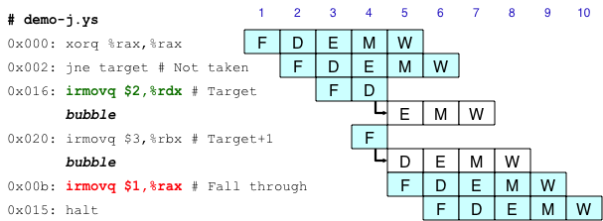
Handling Misprediction
Predict branch as taken
Fetch 2 instructions at target
Cancel when mispredicted
Detect branch not-taken in execute stage
On following cycle, replace instructions in execute and decode by bubbles
No side effects have occurred yet

Slide 50
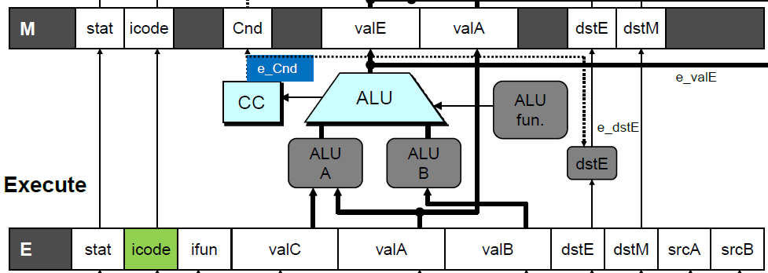
Detecting Mispredicted Branch
Condition | Trigger
Mispredicted Branch | E_icode == IJXX & !e_Cnd

Slide 51
Control for Misprediction
Condition | F | D | E | M | W
Mispredicted Branch | normal | bubble | bubble | normal | normal

Slide 52
Return Example

Slide 53
Return Example
demo-retb.ys
0x000: irmovq Stack,%rsp # Intialize stack pointer
0x00a: call p # Procedure call
0x013: irmovq $5,%rsi # Return point
0x01d: halt
0x020: .pos 0x20
0x020: p: irmovq $-1,%rdi # procedure
0x02a: ret
0x02b: irmovq $1,%rax # Should not be executed
0x035: irmovq $2,%rcx # Should not be executed
0x03f: irmovq $3,%rdx # Should not be executed
0x049: irmovq $4,%rbx # Should not be executed
0x100: .pos 0x100
0x100: Stack: # Stack: Stack pointer
Previously executed three additional instructions

Slide 54
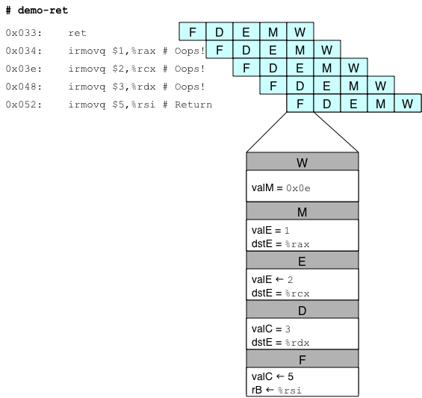
Incorrect Return Example
Incorrectly execute 3 instructions following ret

Slide 55
Correct Return Example
# demo
-
retb
0x026: ret
F
D
E
M
W
bubble
F
D
E
M
W
bubble
F
D
E
M
W
bubble
F
D
E
M
W
F
F
D
D
E
E
M
M
W
0x013:
irmovq
$5,%
rsi
# Return
W
As ret passes through pipeline, stall at fetch stage
While in decode, execute, and memory stage
Inject bubble into decode stage
Release stall when reach write-back stage
W
W
valM
valM
=
=
0x0b
0x013
•
•
•
F
F
f
valC
f
valC
5
5
f
rB
f
rB
%
%
rsi
esi

Slide 56
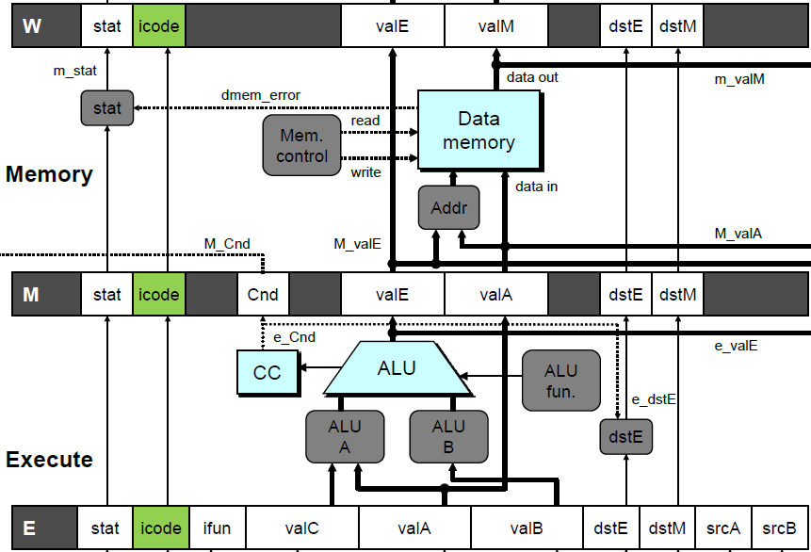
Detecting Return
Condition | Trigger
Processing ret | IRET in { D_icode, E_icode, M_icode }

Slide 57
Control for Return
# demo
-
retb
0x026: ret
F
D
E
M
W
bubble
F
D
E
M
W
bubble
F
D
E
M
W
bubble
F
D
E
M
W
F
F
D
D
E
E
M
M
W
0x014:
irmovq
$5,%
rsi
# Return
W
Condition | F | D | E | M | W
Processing ret | stall | bubble | normal | normal | normal

Slide 58
Special Control Cases
Detection
Action (on next cycle)
Condition | Trigger
Processing ret | IRET in { D_icode, E_icode, M_icode }
Load/Use Hazard | E_icode in { IMRMOVQ, IPOPQ } && E_dstM in { d_srcA, d_srcB }
Mispredicted Branch | E_icode = IJXX & !e_Cnd
Condition | F | D | E | M | W
Processing ret | stall | bubble | normal | normal | normal
Load/Use Hazard | stall | stall | bubble | normal | normal
Mispredicted Branch | normal | bubble | bubble | normal | normal

Slide 59
Implementing Pipeline Control
Combinational logic generates pipeline control signals
Action occurs at start of following cycle

Slide 60
Initial Version of Pipeline Control
bool F_stall =
# Conditions for a load/use hazard
E_icode in { IMRMOVQ, IPOPQ } && E_dstM in { d_srcA, d_srcB } ||
# Stalling at fetch while ret passes through pipeline
IRET in { D_icode, E_icode, M_icode };
bool D_stall =
# Conditions for a load/use hazard
E_icode in { IMRMOVQ, IPOPQ } && E_dstM in { d_srcA, d_srcB };
bool D_bubble =
# Mispredicted branch
(E_icode == IJXX && !e_Cnd) ||
# Stalling at fetch while ret passes through pipeline
IRET in { D_icode, E_icode, M_icode };
bool E_bubble =
# Mispredicted branch
(E_icode == IJXX && !e_Cnd) ||
# Load/use hazard
E_icode in { IMRMOVQ, IPOPQ } && E_dstM in { d_srcA, d_srcB };

Slide 61
Control Combinations

Slide 62
Control Combinations
Special cases that can arise on same clock cycle
Combination A
Not-taken branch
ret instruction at branch target
Combination B
Instruction that reads from memory to %rsp
Followed by ret instruction

Slide 63
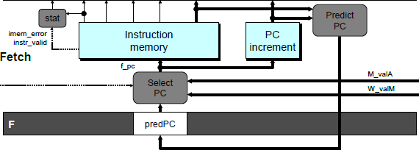
Control Combination A
1
1
Mispredict
1
Mispredict
ret
ret
ret
M
M
M
M
M
JXX
E
JXX
E
E
E
E
ret
ret
D
ret
D
D
D
D
Combination A
Condition | F | D | E | M | W
Processing ret | stall | bubble | normal | normal | normal
Mispredicted Branch | normal | bubble | bubble | normal | normal
Combination | stall | bubble | bubble | normal | normal
Should handle as mispredicted branch
Stalls F pipeline register
But PC selection logic will be using M_valM anyhow

Slide 64
Control Combination B
1
1
Load/use
ret
1
ret
ret
M
M
M
M
E
Load
E
E
E
Use
ret
ret
D
D
ret
D
D
Combination B
Condition | F | D | E | M | W
Processing ret | stall | bubble | normal | normal | normal
Load/Use Hazard | stall | stall | bubble | normal | normal
Combination | stall | bubble + stall | bubble | normal | normal
Would attempt to bubble and stall pipeline register D
Signaled by processor as pipeline error

Slide 65
Handling Control Combination B
1
1
Load/use
ret
1
ret
ret
M
M
M
M
E
Load
E
E
E
Use
ret
ret
D
D
ret
D
D
Combination B
Condition | F | D | E | M | W
Processing ret | stall | bubble | normal | normal | normal
Load/Use Hazard | stall | stall | bubble | normal | normal
Combination | stall | stall | bubble | normal | normal
Load/use hazard should get priority
ret instruction should be held in decode stage for additional cycle

Slide 66
Corrected Pipeline Control Logic
bool D_bubble =
# Mispredicted branch
(E_icode == IJXX && !e_Cnd) ||
# Stalling at fetch while ret passes through pipeline
IRET in { D_icode, E_icode, M_icode }
# but not condition for a load/use hazard
&& !(E_icode in { IMRMOVQ, IPOPQ }
&& E_dstM in { d_srcA, d_srcB });
Condition | F | D | E | M | W
Processing ret | stall | bubble | normal | normal | normal
Load/Use Hazard | stall | stall | bubble | normal | normal
Combination | stall | stall | bubble | normal | normal
Load/use hazard should get priority
ret instruction should be held in decode stage for additional cycle

Slide 67
Pipeline Part 1: Summary
Concept
Break instruction execution into 5 stages
Run instructions through in pipelined mode
Limitations
Can’t handle dependencies between instructions when instructions follow too closely
Data dependencies
One instruction writes register, later one reads it
Control dependency
Instruction sets PC in way that pipeline did not predict correctly
Mispredicted branch and return
Fixing the Pipeline
We’ll do that next time

Slide 68
Pipeline Part 2: Summary
Data Hazards
Most handled by forwarding
No performance penalty
Load/use hazard requires one cycle stall
Control Hazards
Cancel instructions when detect mispredicted branch
Two clock cycles wasted
Stall fetch stage while ret passes through pipeline
Three clock cycles wasted
Control Combinations
Must analyze carefully
First version had subtle bug
Only arises with unusual instruction combination

